Slide 1
DATA SCIENCE, OPEN SOURCE, & RADICAL TRANSPARENCY
Andrew Heiss, PhD
Georgia State University
October 10, 2019
@andrewheiss

Slide 2
DATA, DATA SCIENCE, & PUBLIC SERVICE

Slide 3

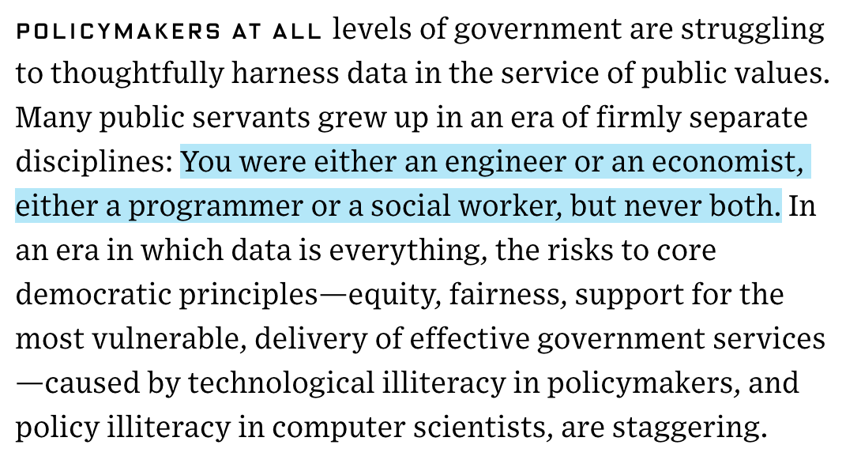
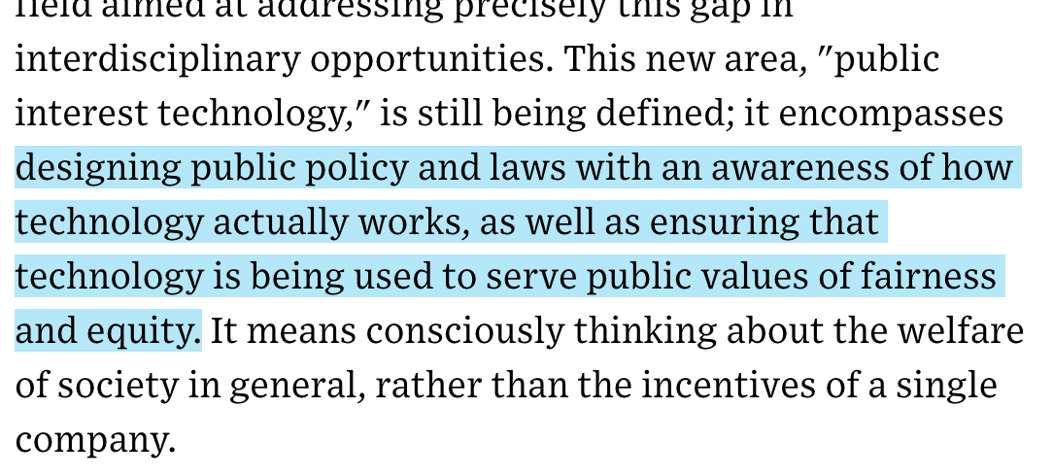
Notes:
https://www.wired.com/story/universities-public-interest-technology-courses-programs/

Slide 4



DATA AND GOVERNMENT
“To responsibly unleash the power of data to benefit all Americans”

Slide 5
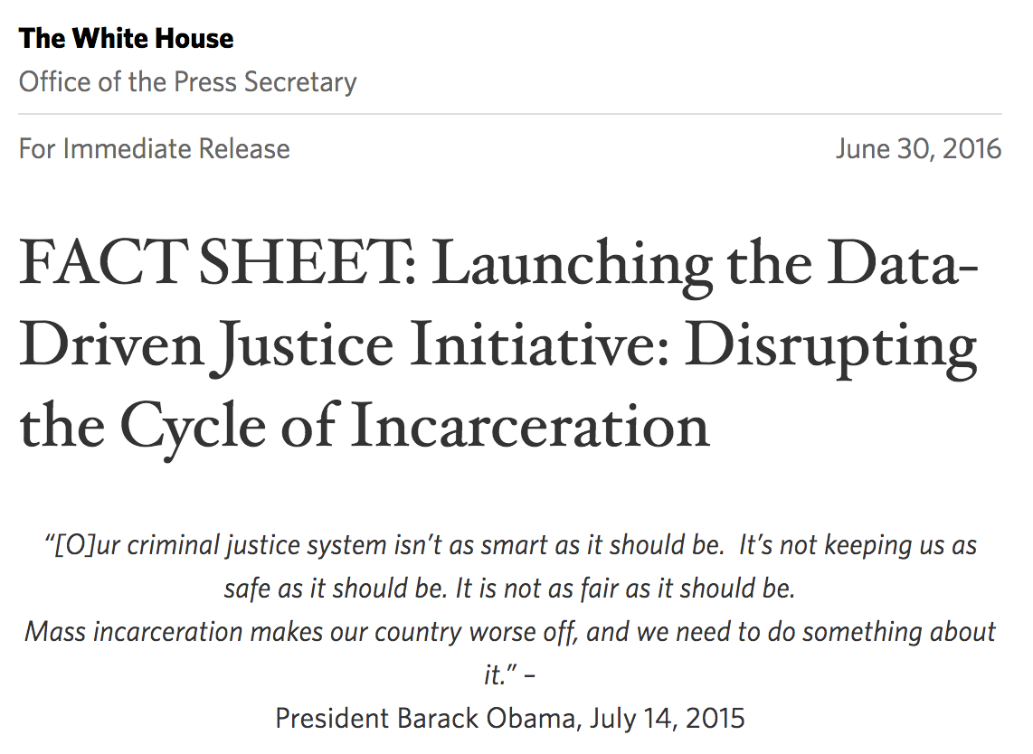
Notes:
11.4 million people + 23 days
Data shared between agencies – arresting officer checks database, sees if person has been cycling, sees if they need mental health services
Two jails in Florida closed after this

Slide 6
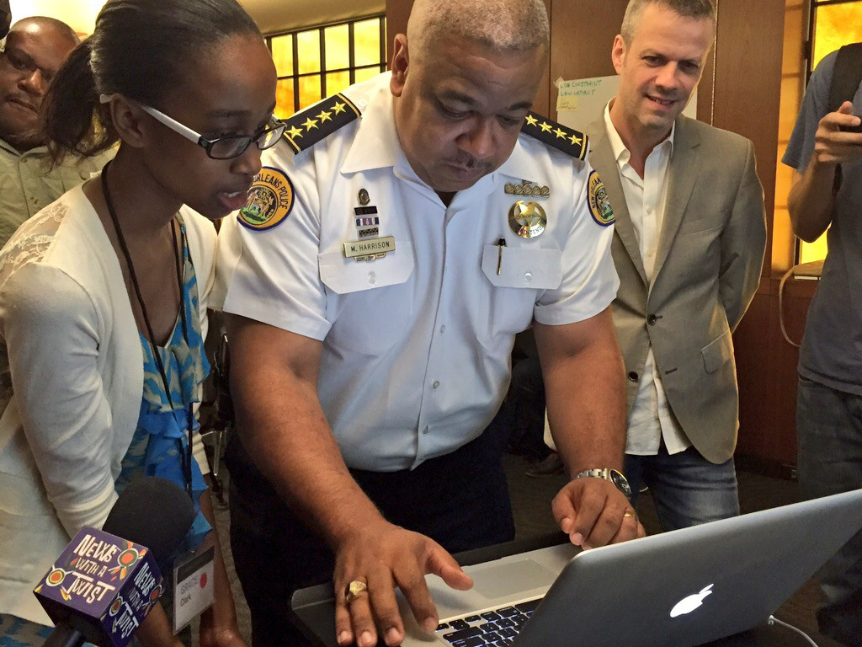

Slide 7

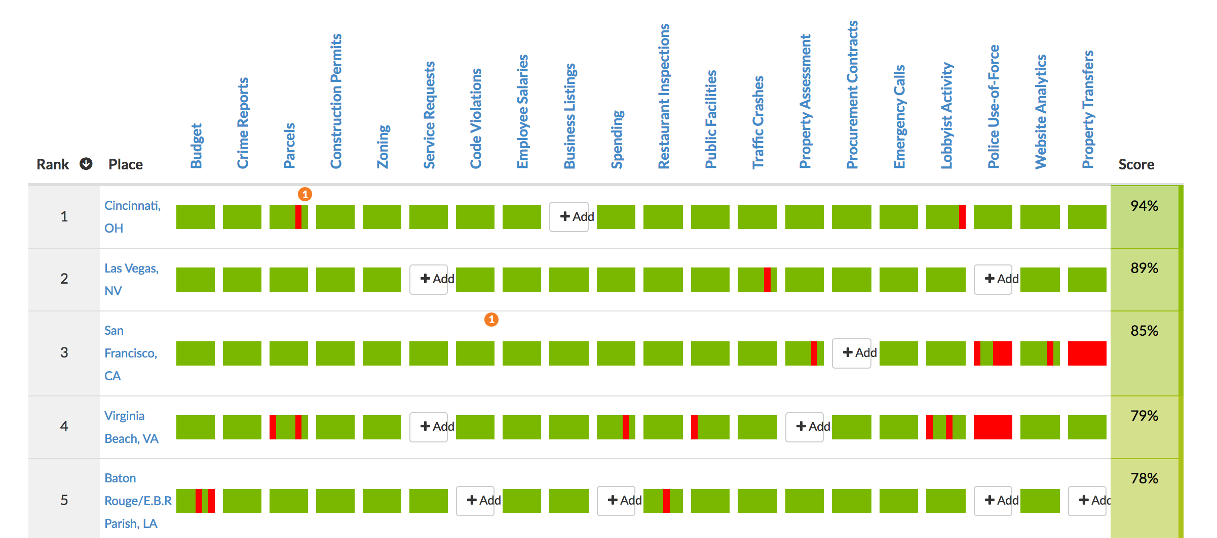
Notes:
Open data galore
http://us-cities.survey.okfn.org/

Slide 8
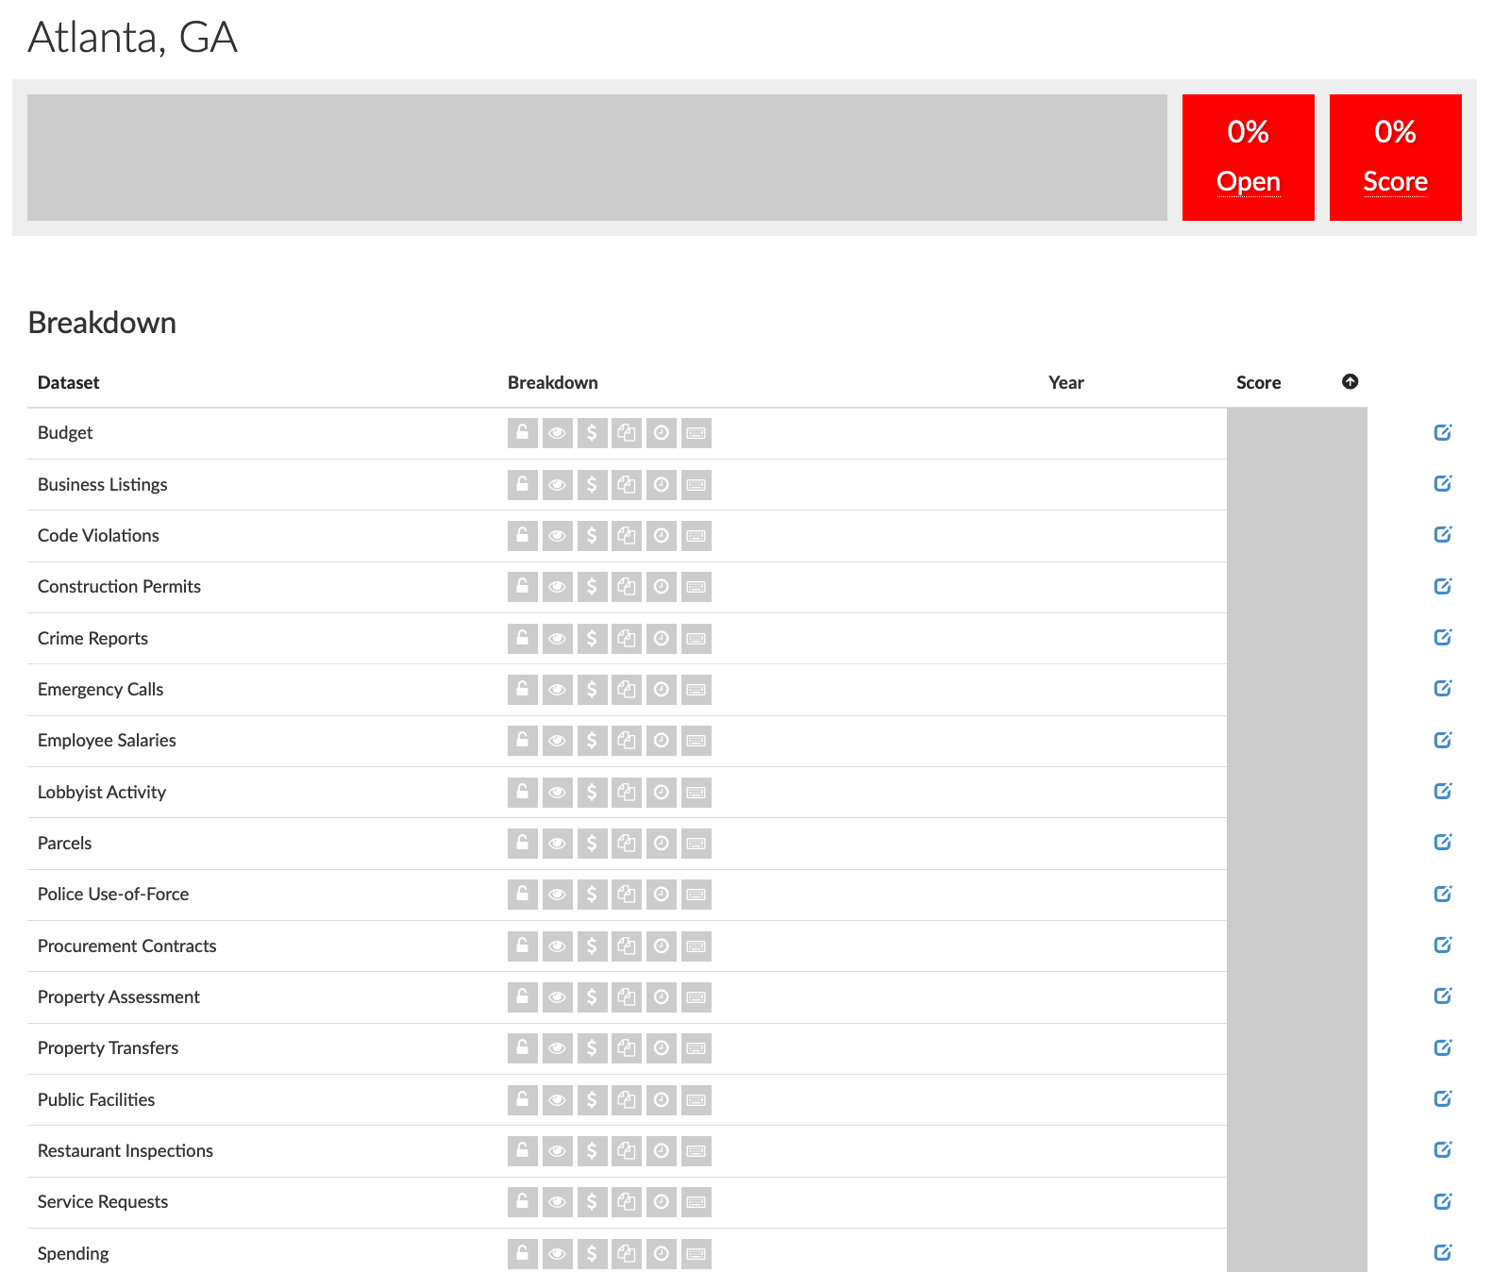

Slide 9
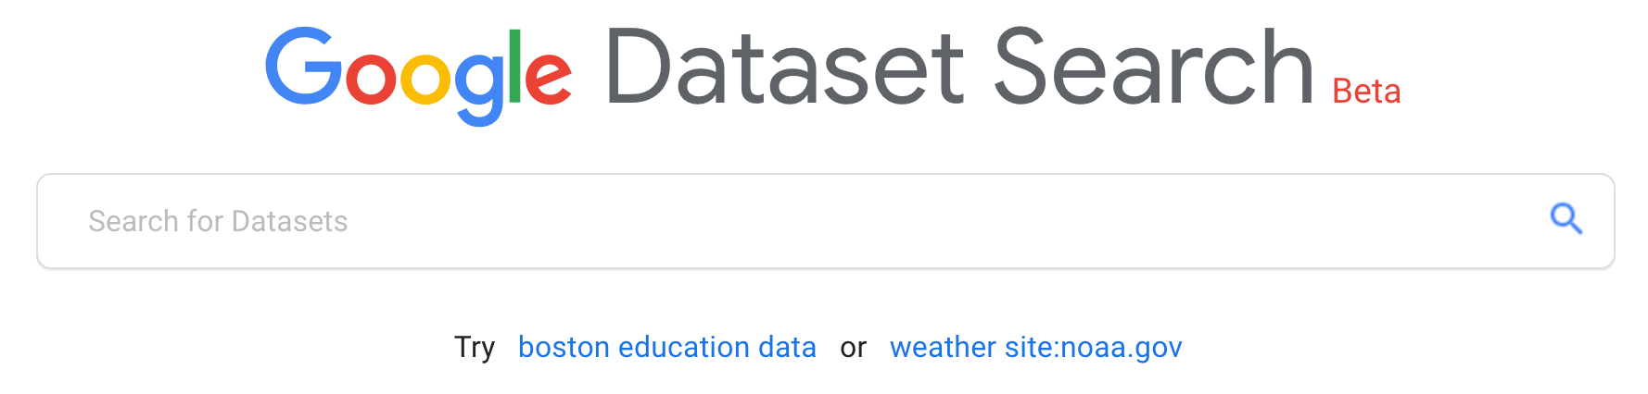
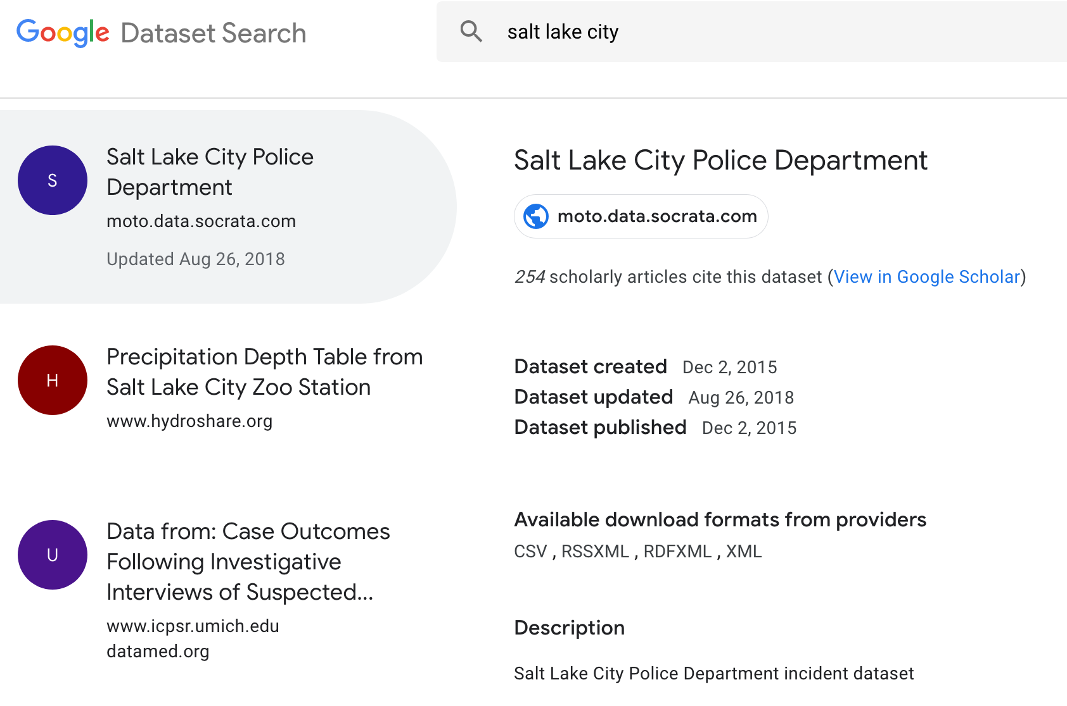

Slide 10
How do you use all this data to make the world better?

Slide 11
WHAT IS “STATISTICS”?
Collecting and analyzing data from a representative sample in order to make inferences about a whole population

Slide 12
WHAT IS “DATA SCIENCE”?
Big data
Algorithms
Machine learning
Data mining
Cloud computing
Neural networks
Artificial intelligence
PR-speak for “statistics”

Slide 13
WHAT IS “DATA SCIENCE”?
Turning raw data into understanding, insight, and knowledge
Collect
Analyze
Communicate

Slide 14
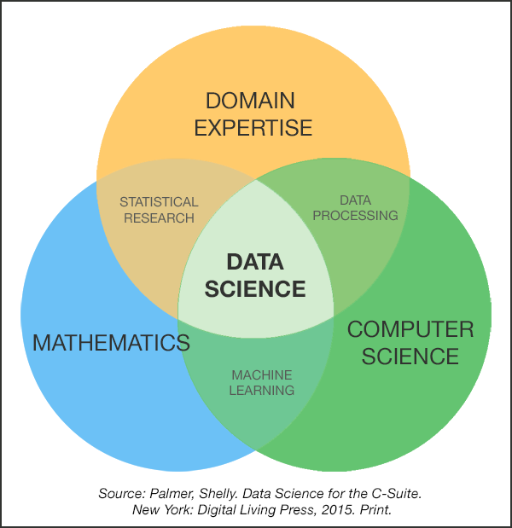
WHAT’S THE DIFFERENCE?
Collect
Statistics
Analyze
Communicate

Slide 15
HOW DO I LEARN HOW TO DO THIS STUFF?

Slide 16
Find excuses to use data science methods!
Dumb dinky projects
Data play time
Actual projects

Slide 17
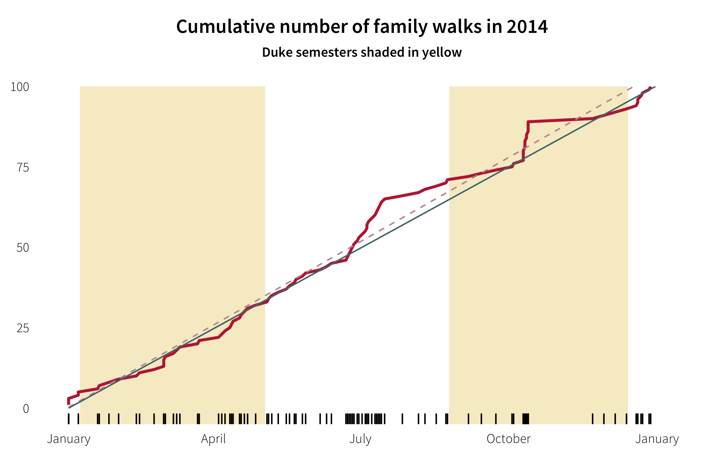
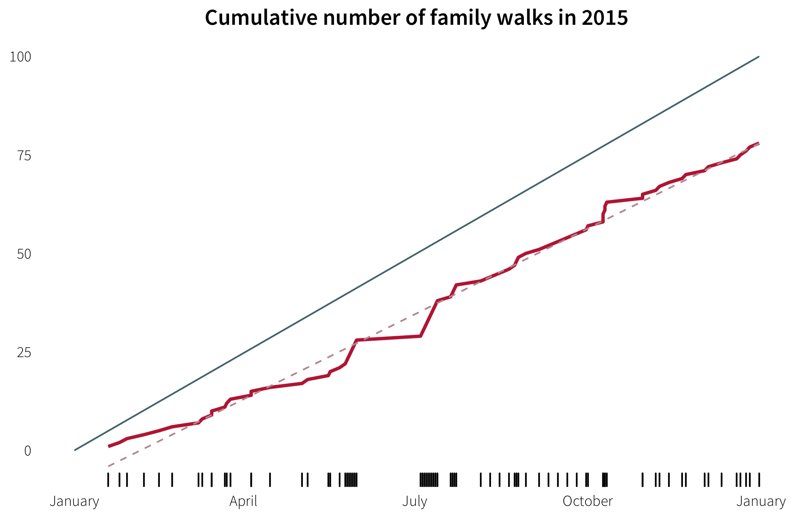

Slide 18
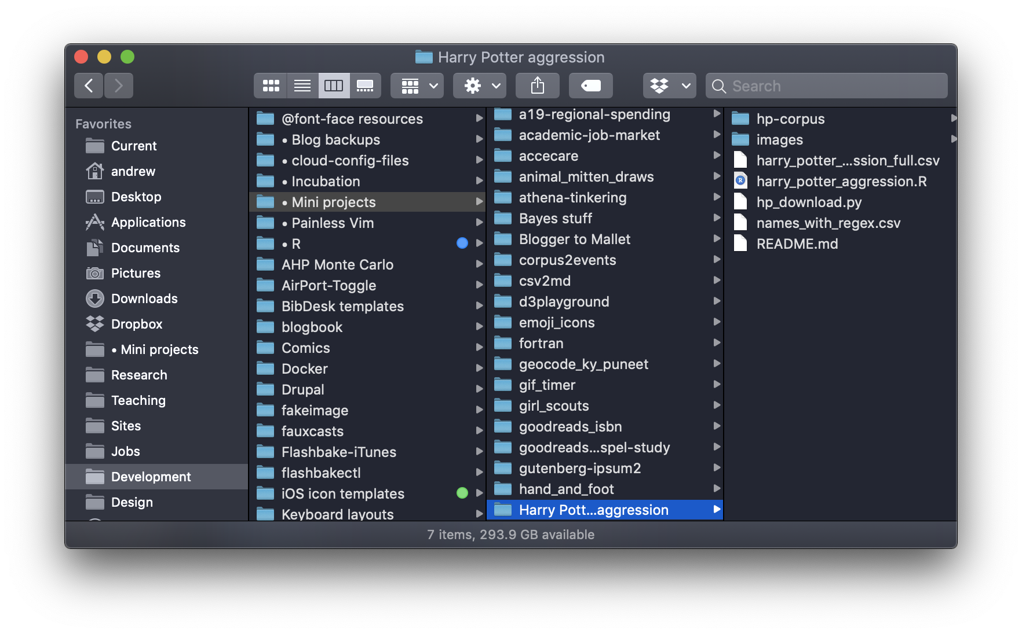

Slide 19
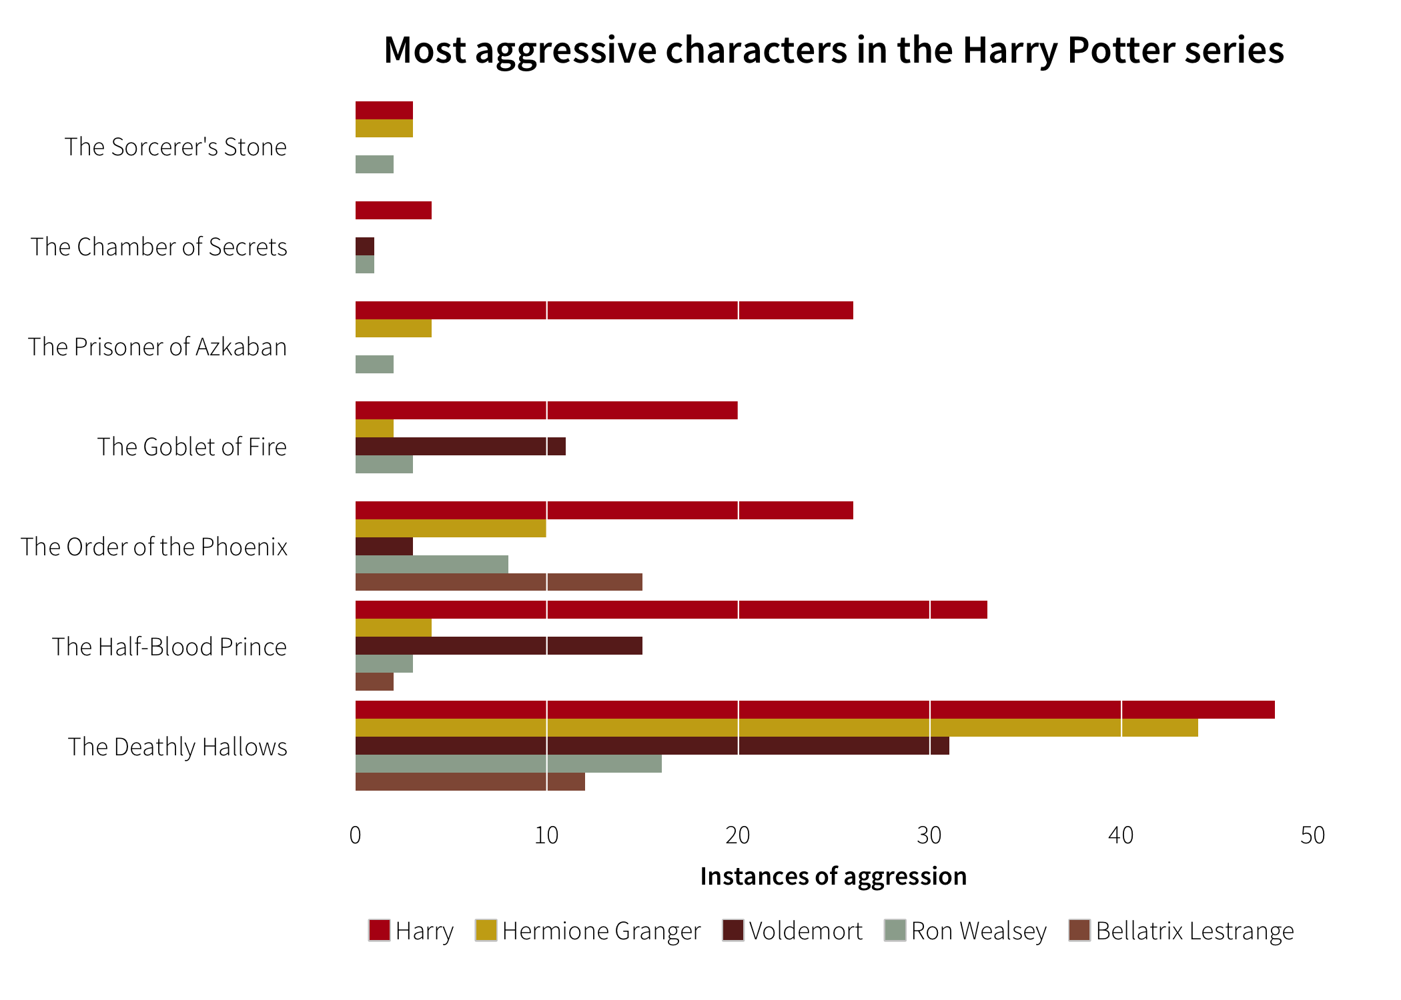

Slide 20
Take classes!
Teach yourself!
Conference sessions
Coursera + online tutorials
Read books

Slide 22
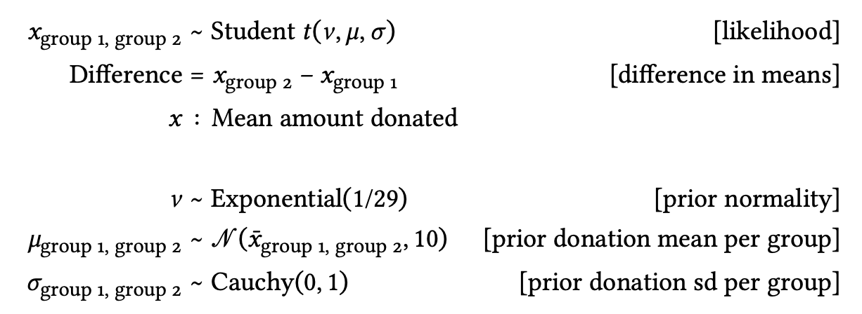

Slide 23

ds4ps.org

Slide 24
RADICAL TRANSPARENCY & PUBLIC WORK

Slide 25
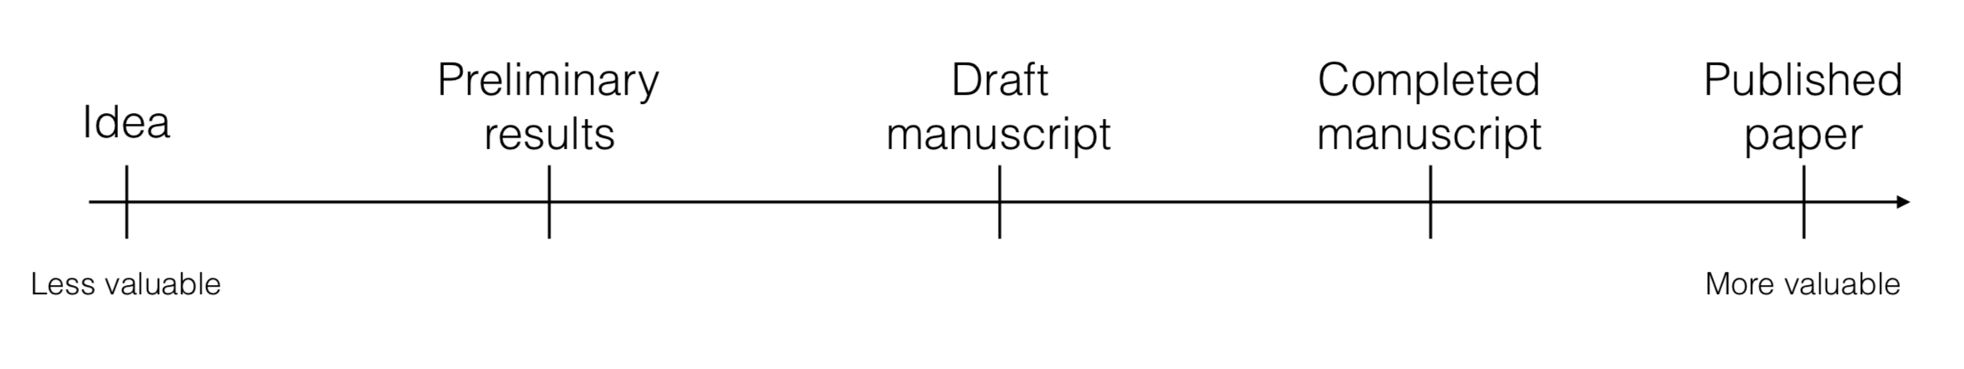
How we normally think of our work and goals

Slide 26
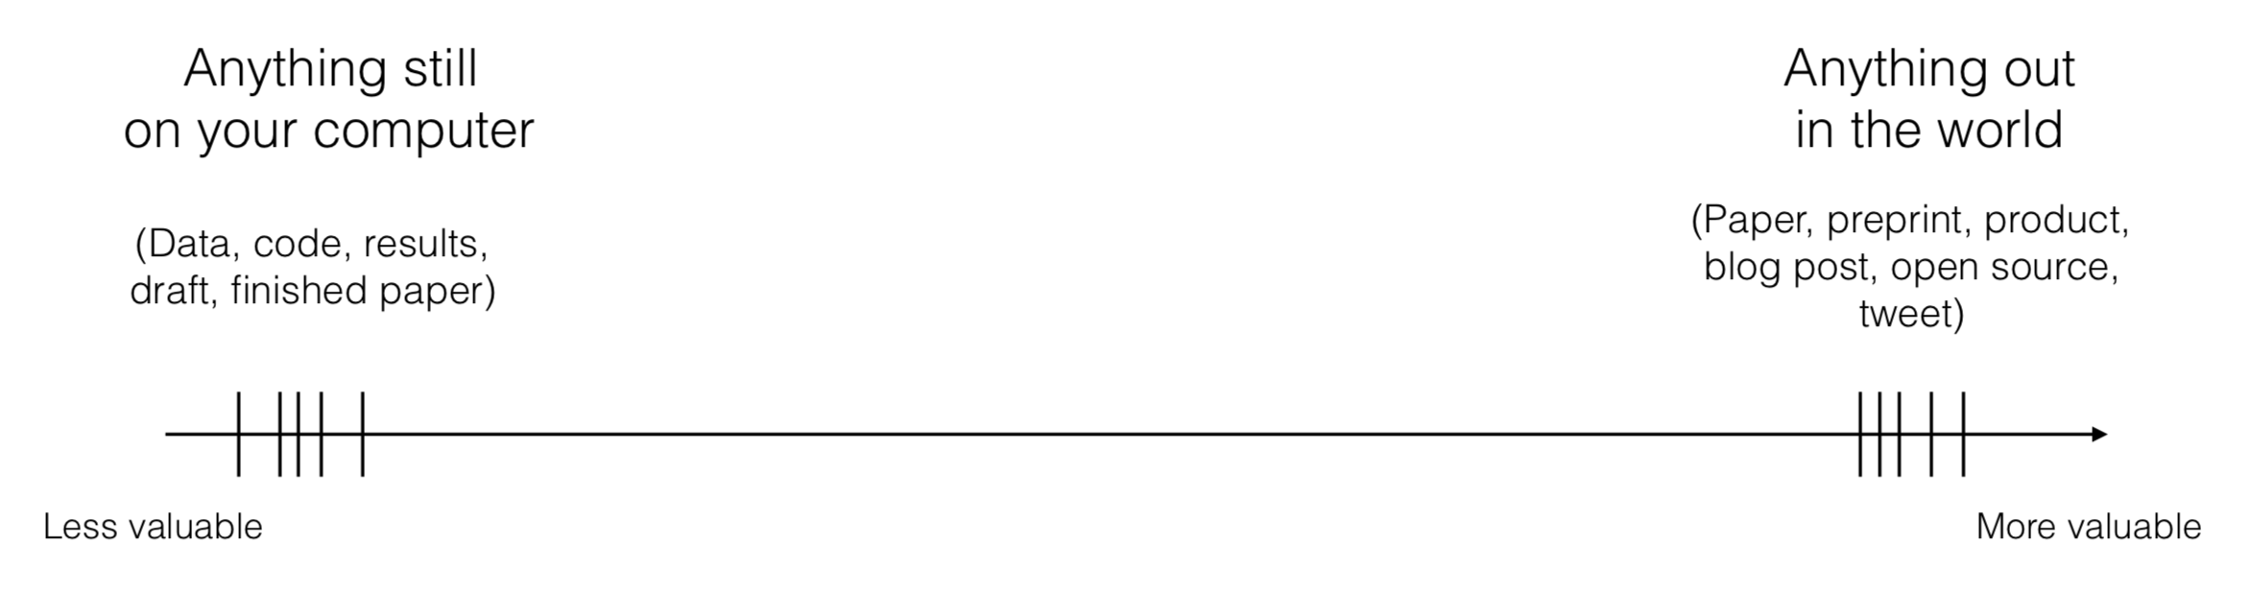
How we should think of our work and goals

Slide 27
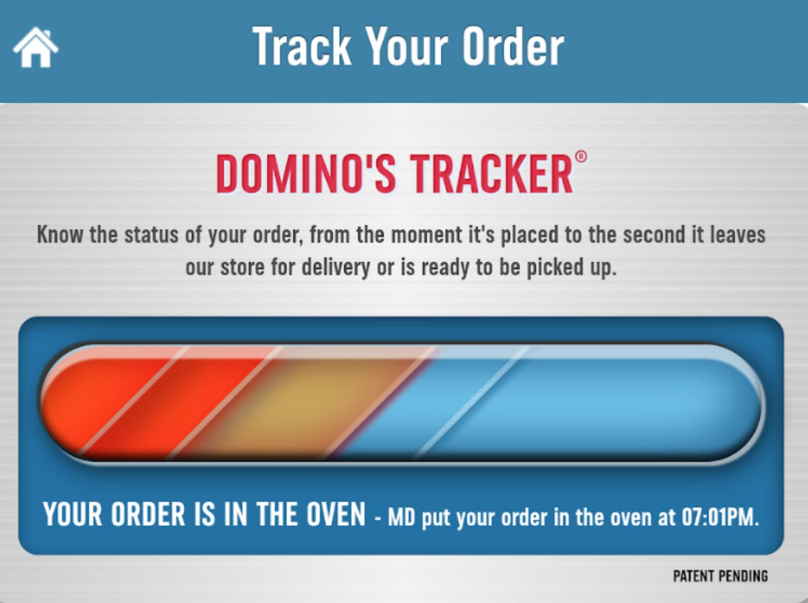
Notes:
https://99percentinvisible.org/episode/wait-wait-tell-me/

Slide 28
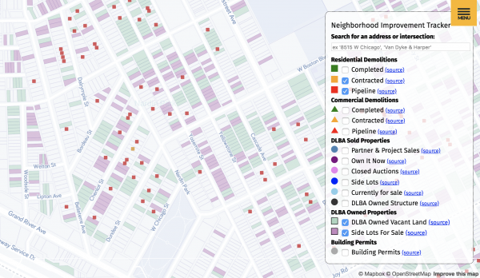
Notes:
https://99percentinvisible.org/episode/wait-wait-tell-me/

Slide 29
Benefits of working in public
Build reputation
Learn more
Grow community
Early feedback on ideas
Validation

Slide 31
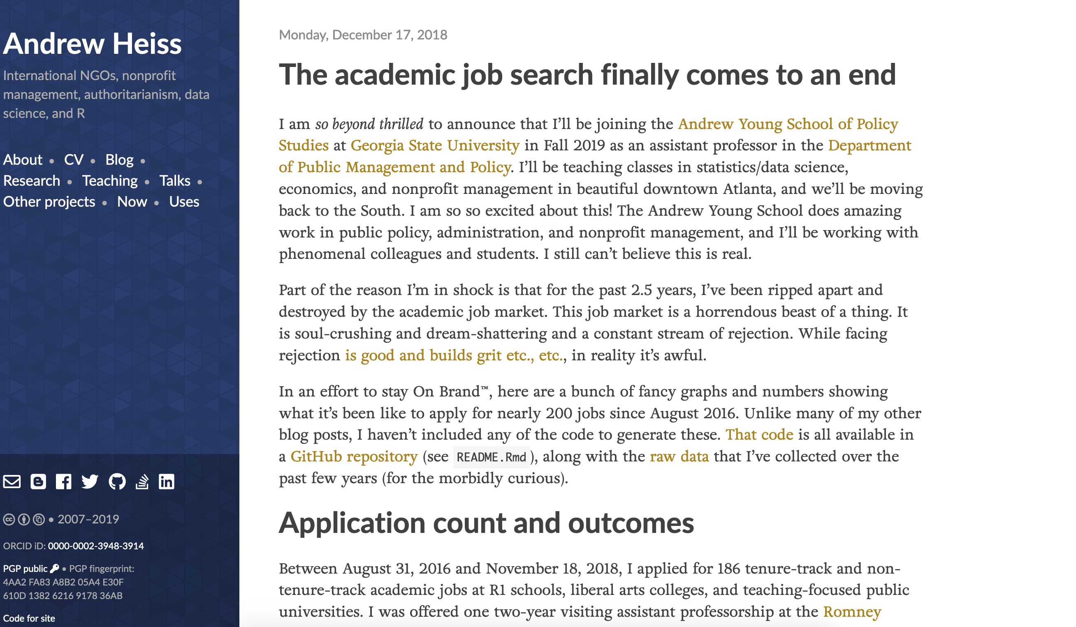

Slide 32
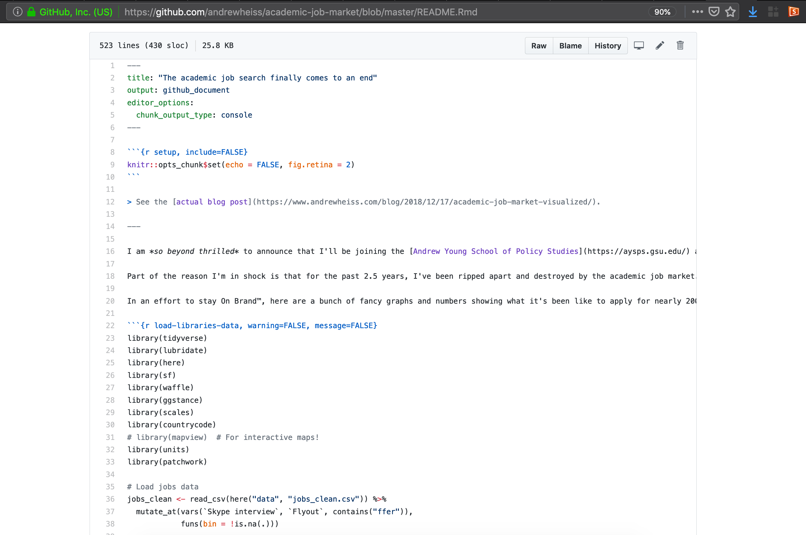

Slide 33
How to work in public
Blog and tweet
Analyze data
Blog about research
Teach concepts
Make research public

Slide 34

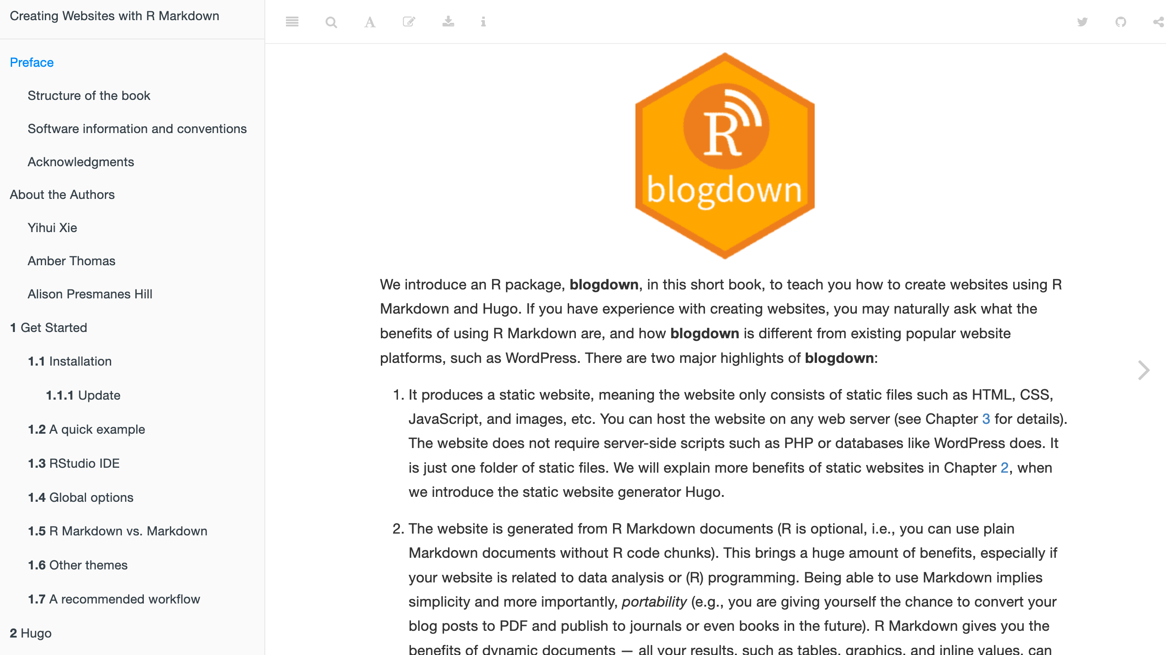
Start a blog

Slide 35
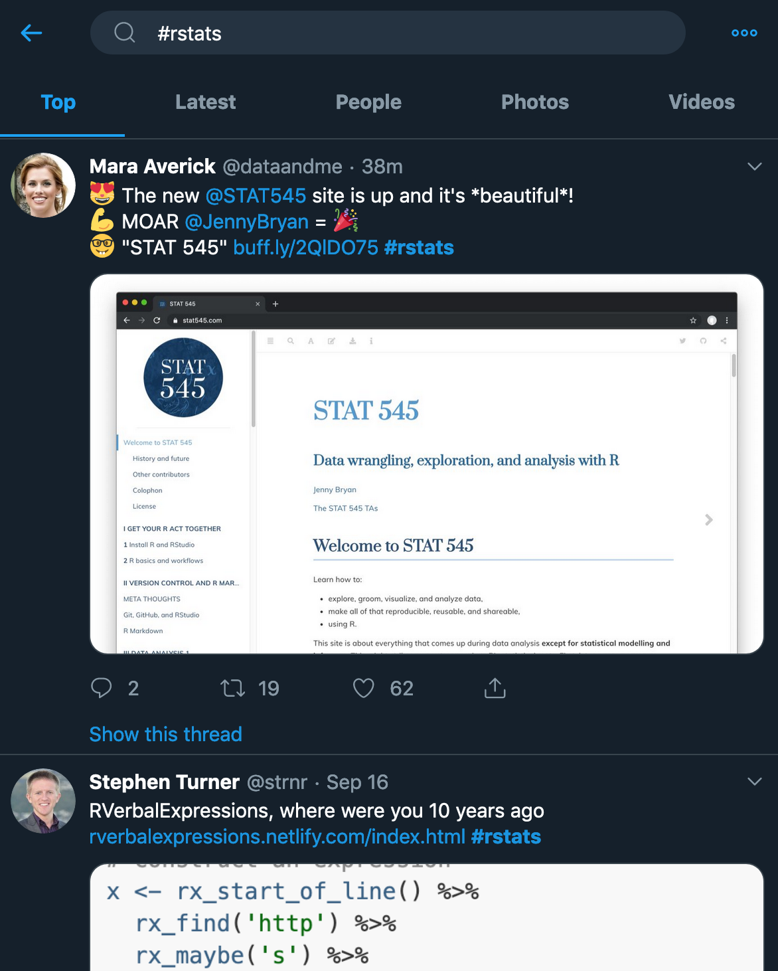
Finding online communities

Slide 36
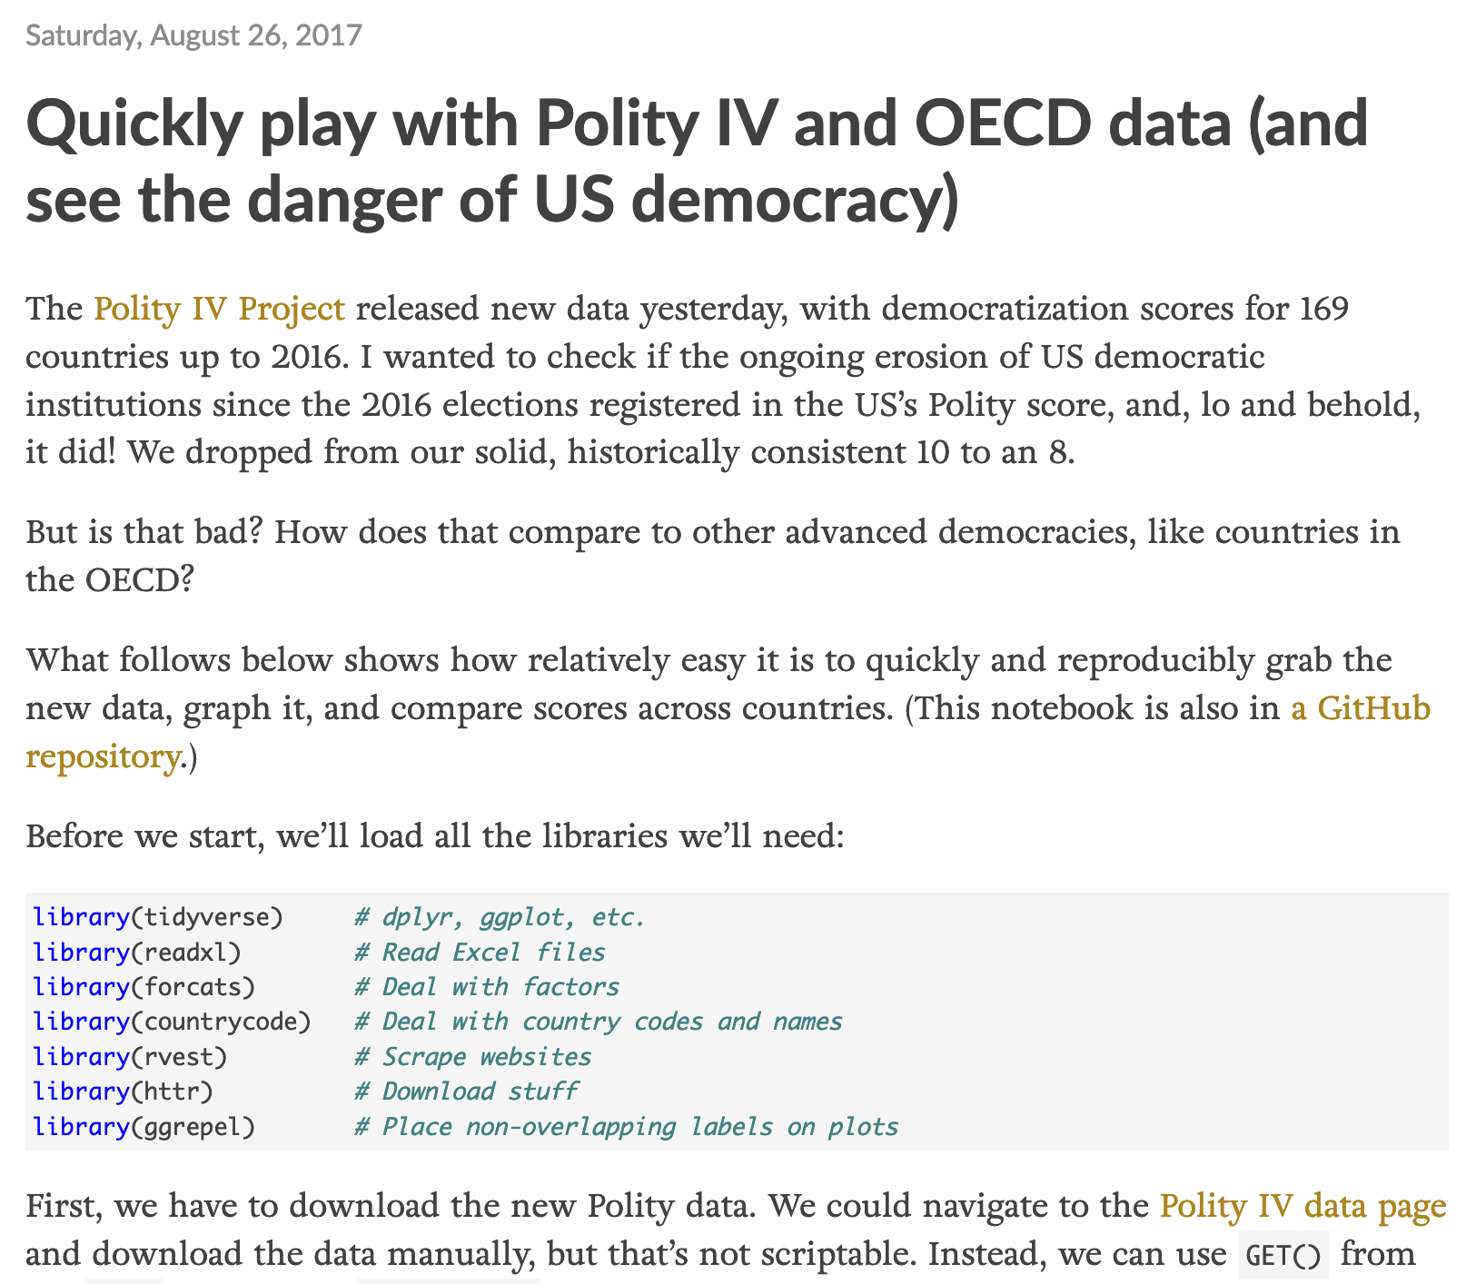
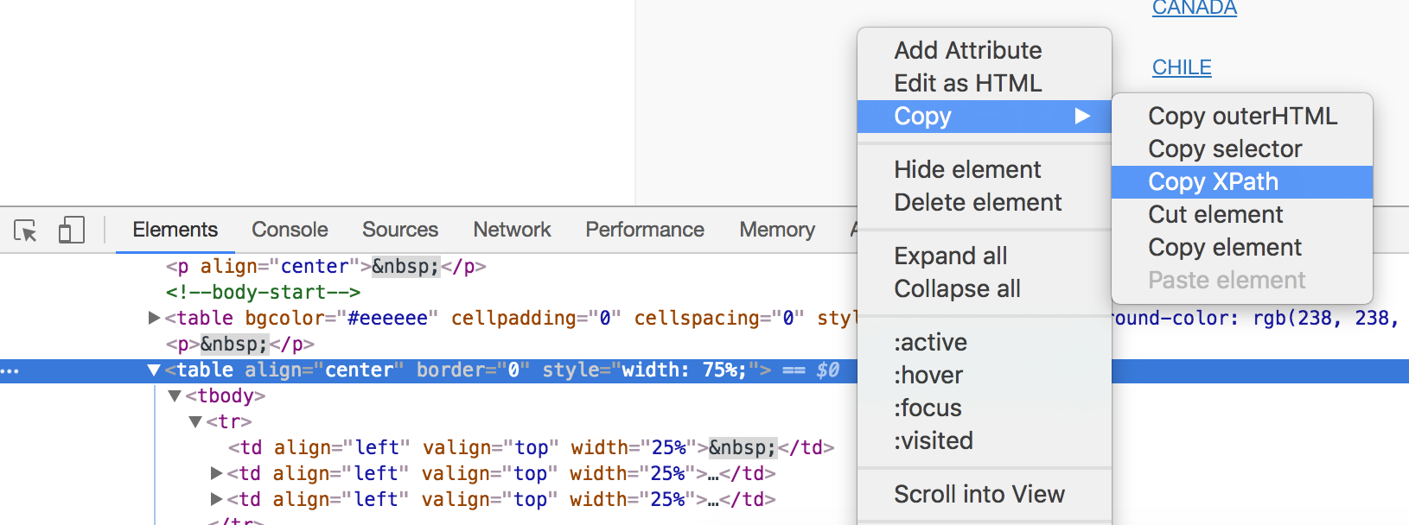
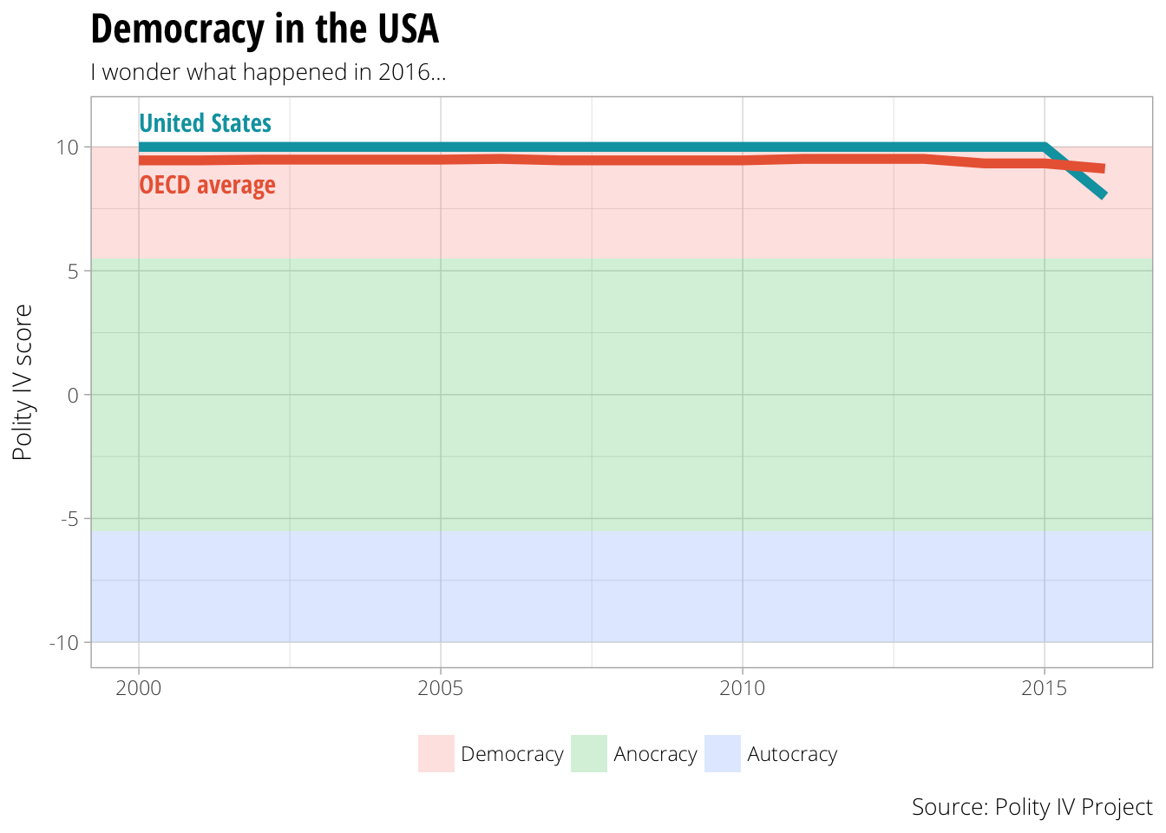
Analyze data

Slide 37
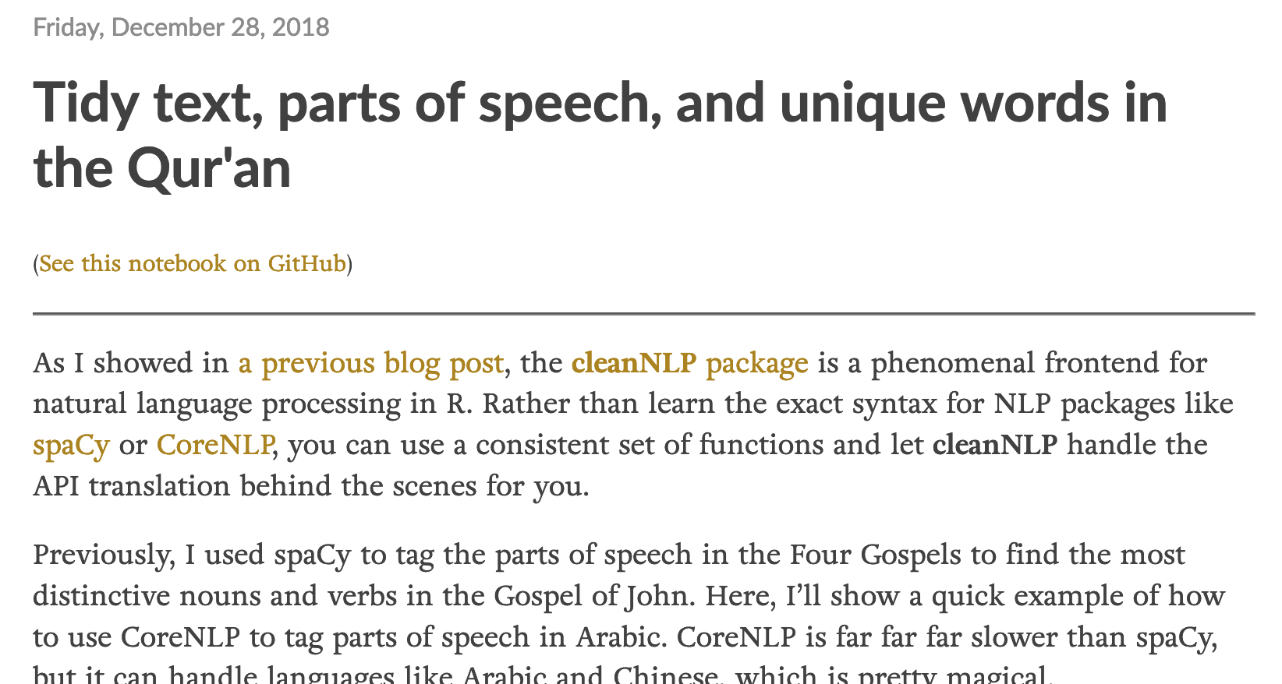
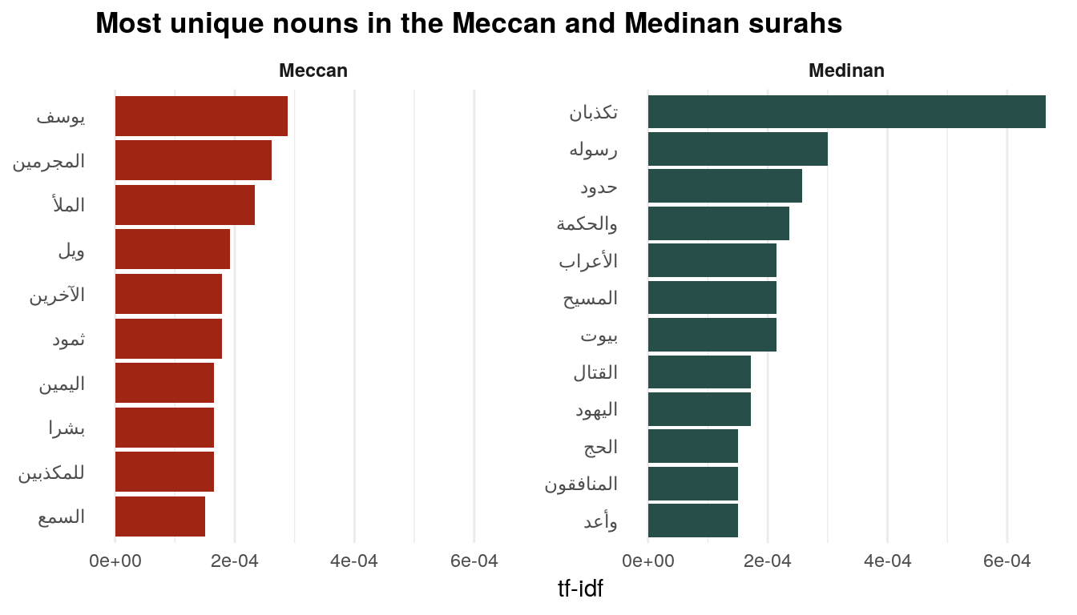
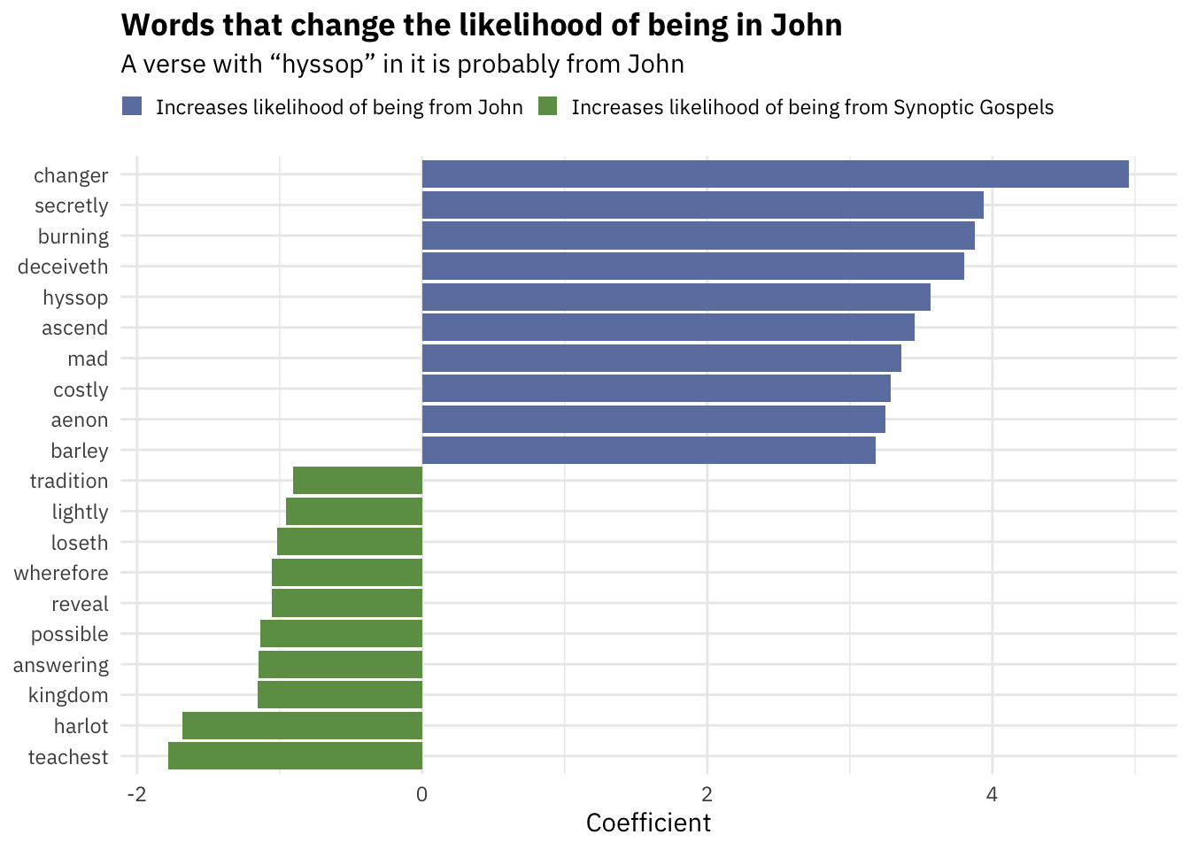


Slide 38
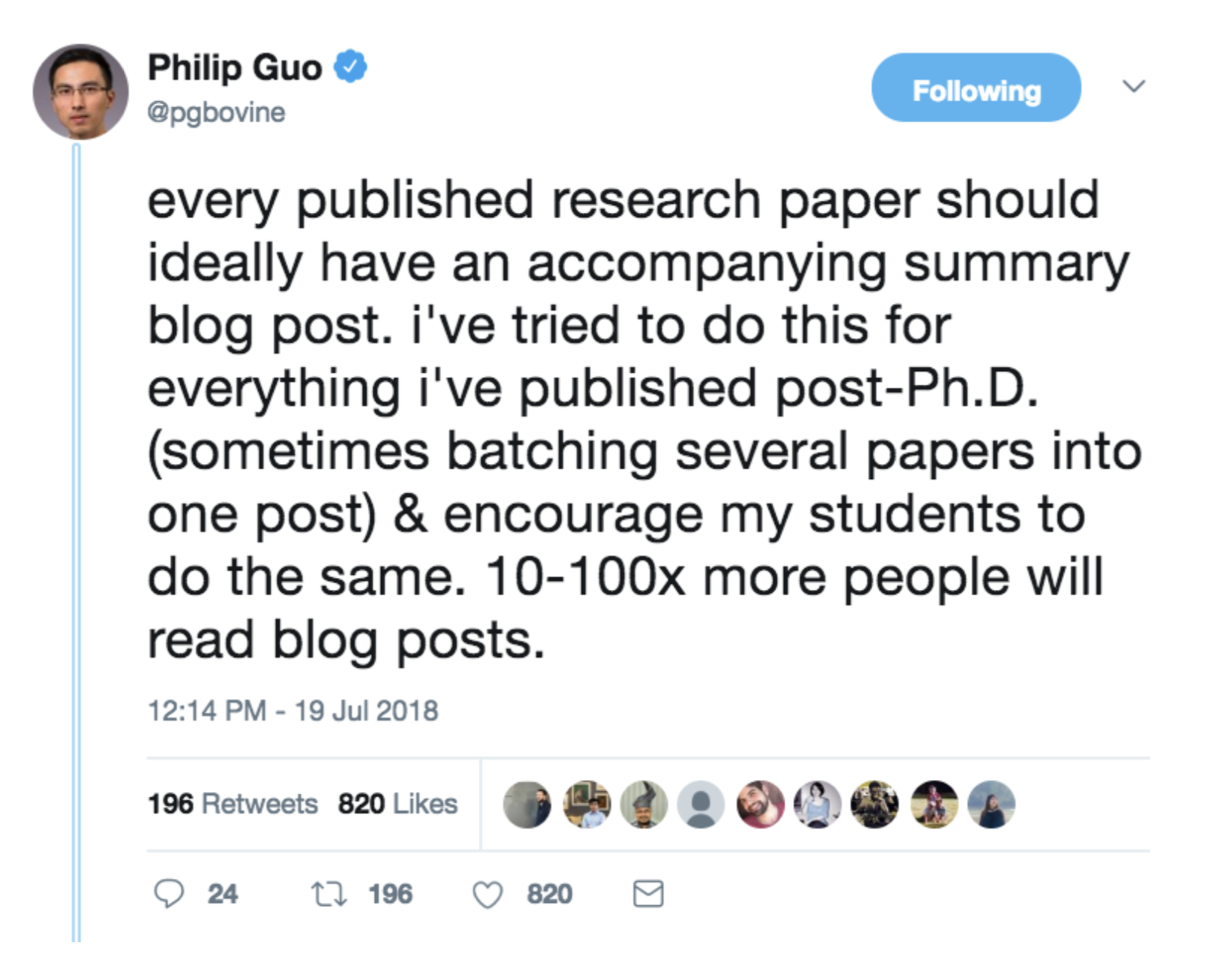
Blog about research

Slide 39
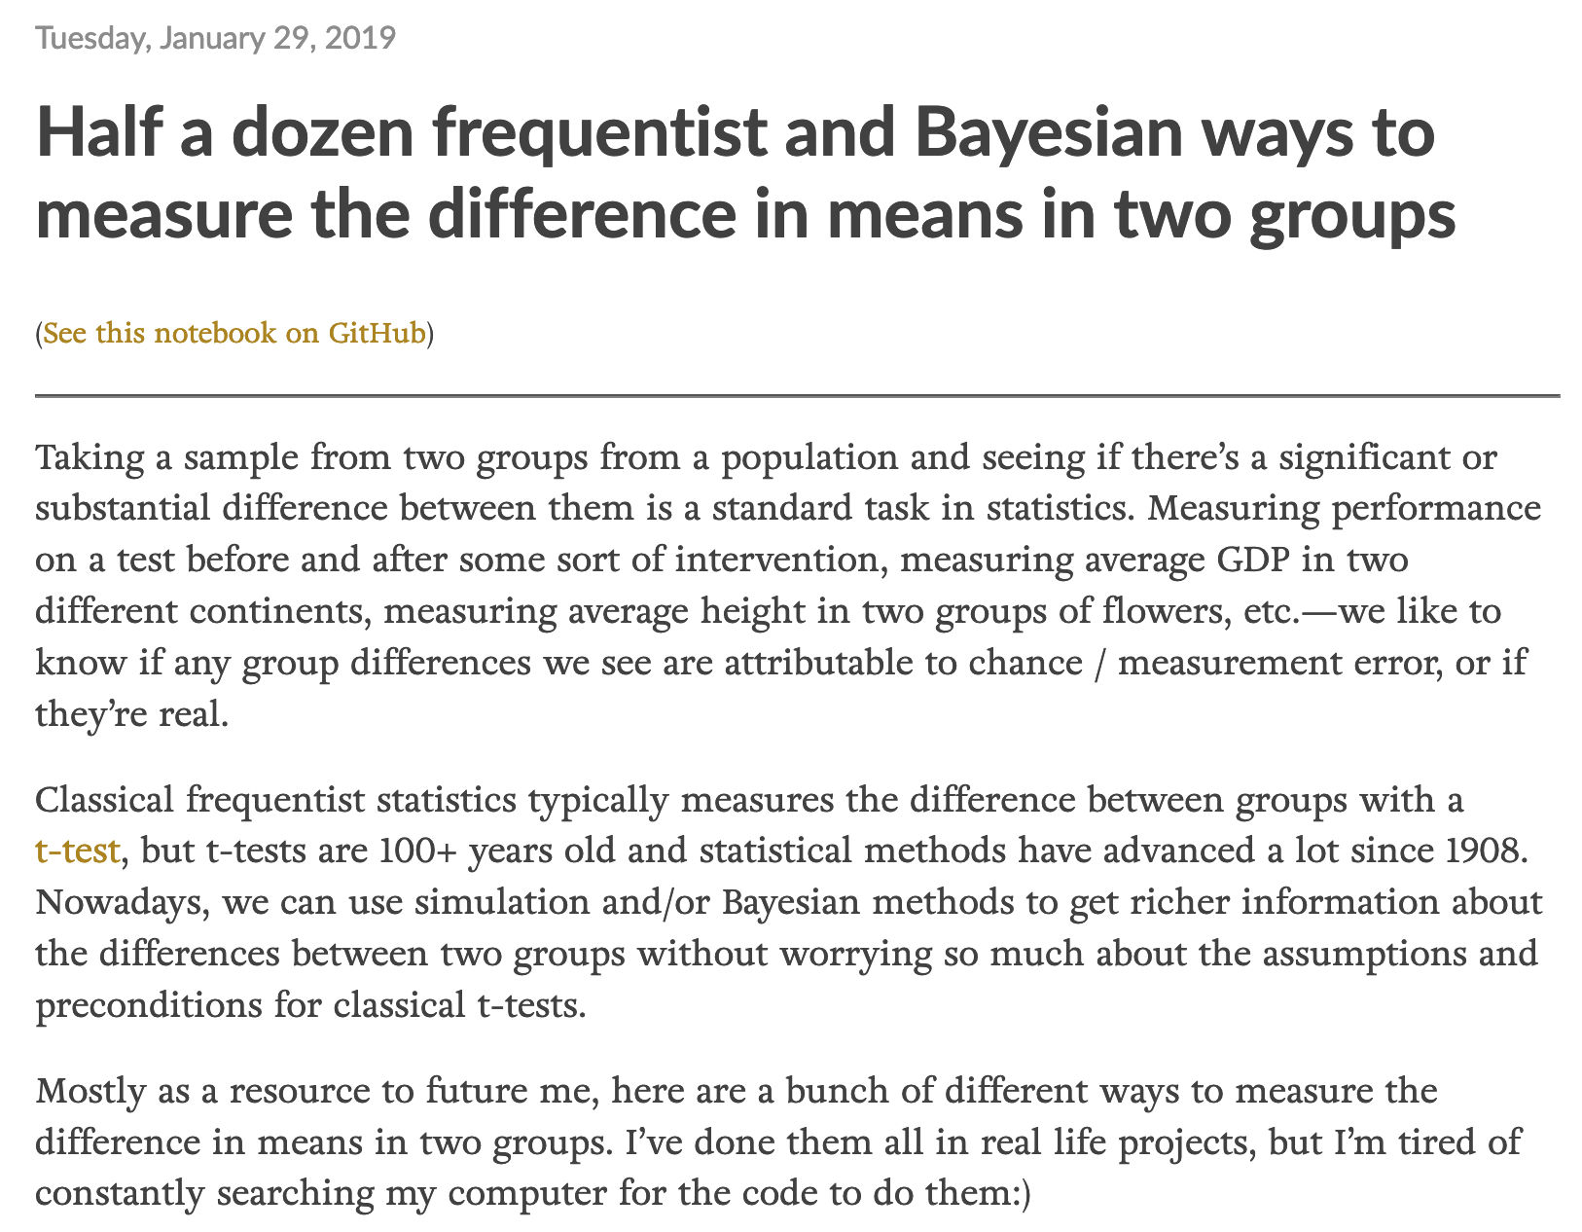
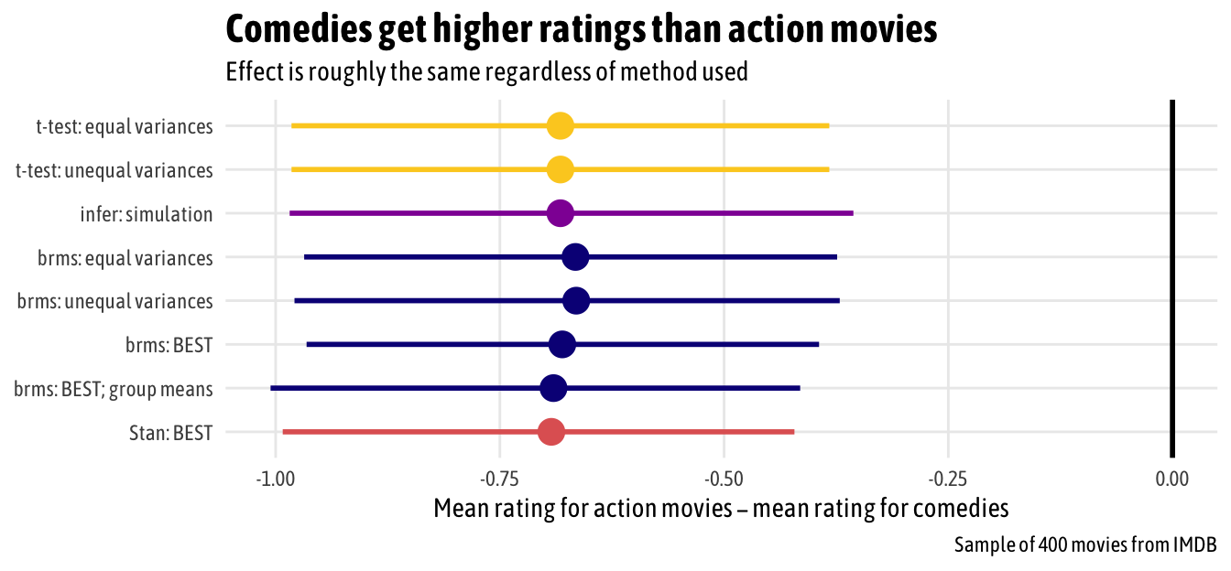
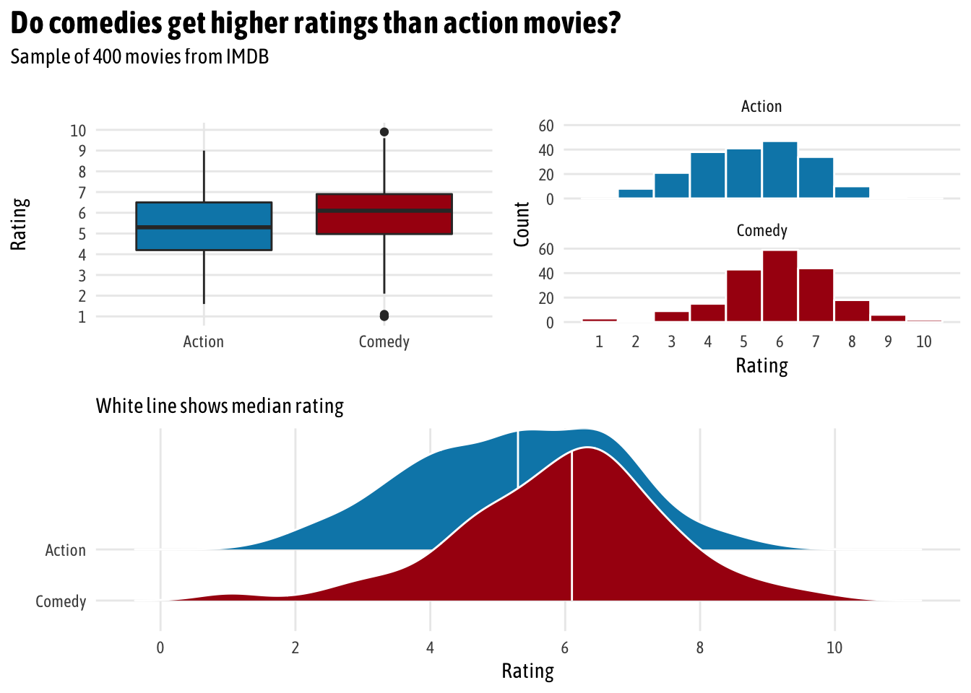
Teach a concept

Slide 40
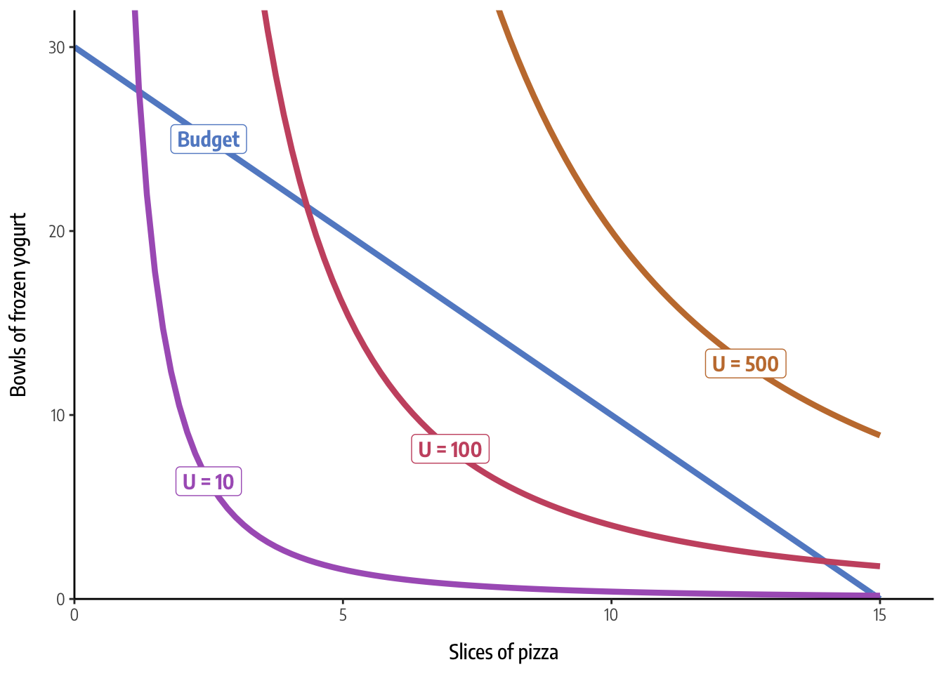

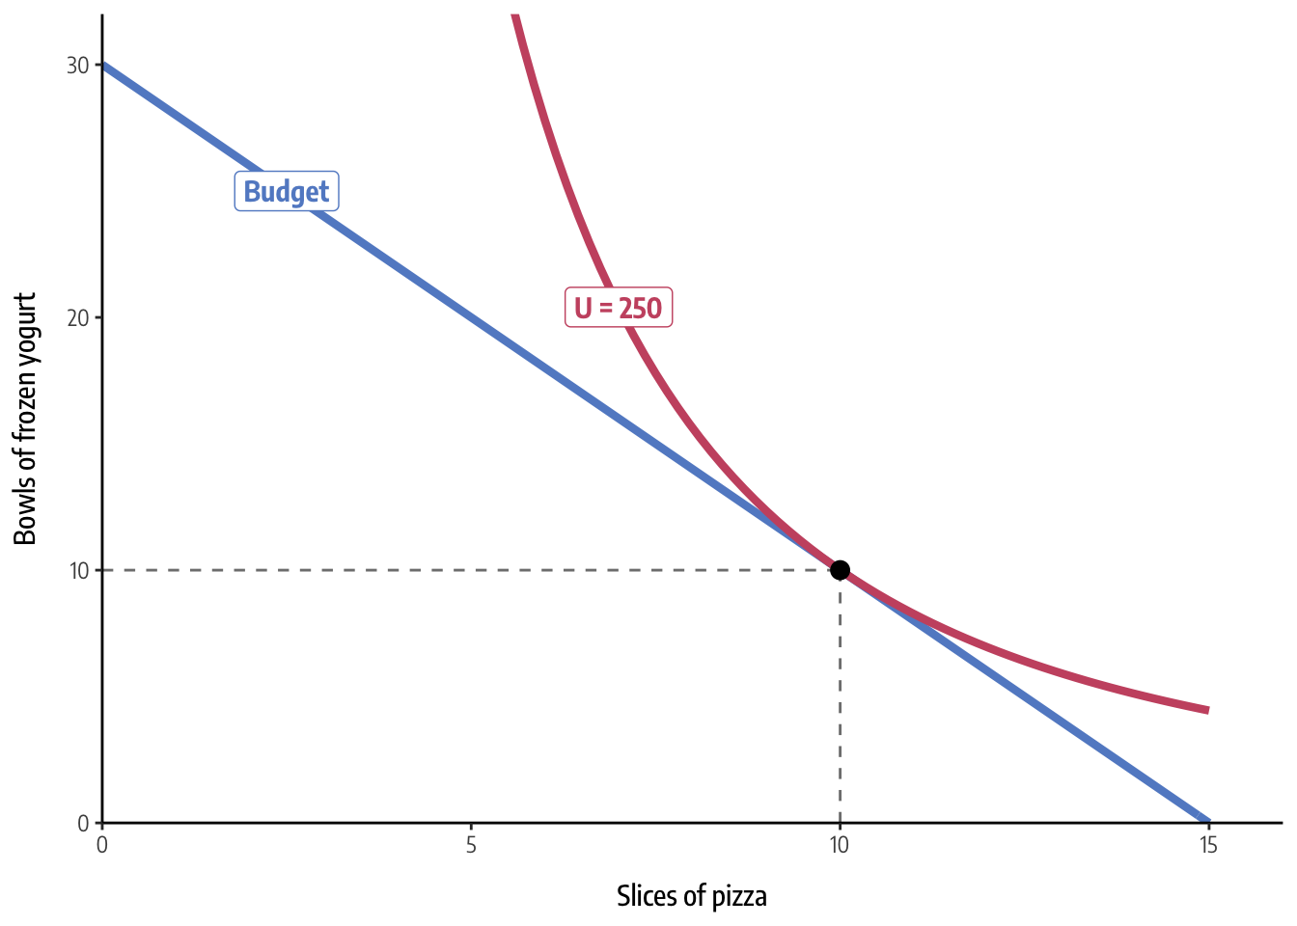

Slide 41

Make research public

Slide 42
